Slide 1


REPORT
WORLD ECONOMIC
INDICATORS
DASHBOARD

Slide 2

WORLD ECONOMICS
Indicators
The indicators within the Economy section allow us to analyze various aspects of both national and global economic activity
Countries produce
Goods
Services
Either to be
Consumed -Trade internationally
The importance of these indicators :
It help measures levels and changes in size and structure of different economies . Also, identify any growth or contractions in the economies

Slide 3
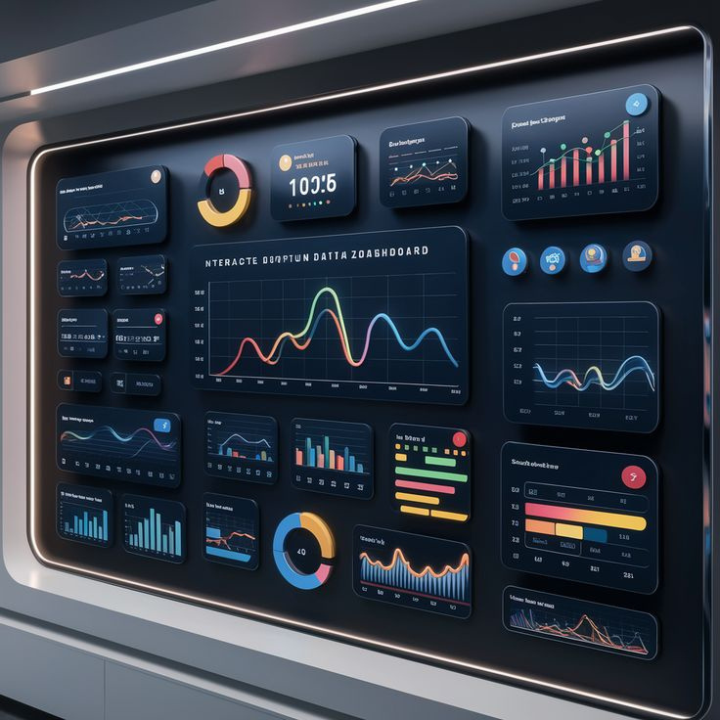
WORLD ECONOMIC INDICATORS
Challenges in Analyzing World Development Indicators Data
COMPLEXITY IN
INTERPRETATION
DATA CONSISTENCY
Multidimensional Data
CORRELATION VS CAUSATION
Variability in Data Collection
Time Lag in Data Updates
RELIABILITY OF DATA
DATA ACCESSIBILITY
Quality’s Source
Political Influence
Language and Format Barriers
Availability of Data

Slide 4

SOLUTIONS TO THE CHALLENGES IN (WDI) DATA
Involve enhancing data collection methods, standardizing reporting practices, and improving the use of internationally recognized sources to ensure the indicators accurately reflect development

Slide 5

WHAT IS MEANT BY THE TERM GDP?
GDP (Gross Domestic Product) is a key economic indicator that measures the total monetary value of all goods and services produced within a country's borders over a specific time period, usually annually or quarterly.
Key Aspects of GDP
Total Output: GDP includes everything produced within a country, from cars and electronics to healthcare and education services.
Market Value: It is measured in monetary terms, reflecting the market value of goods and services.
Domestic Focus: GDP only accounts for production within the country's borders, regardless of whether the companies involved are domestic or foreign-owned.

Slide 6

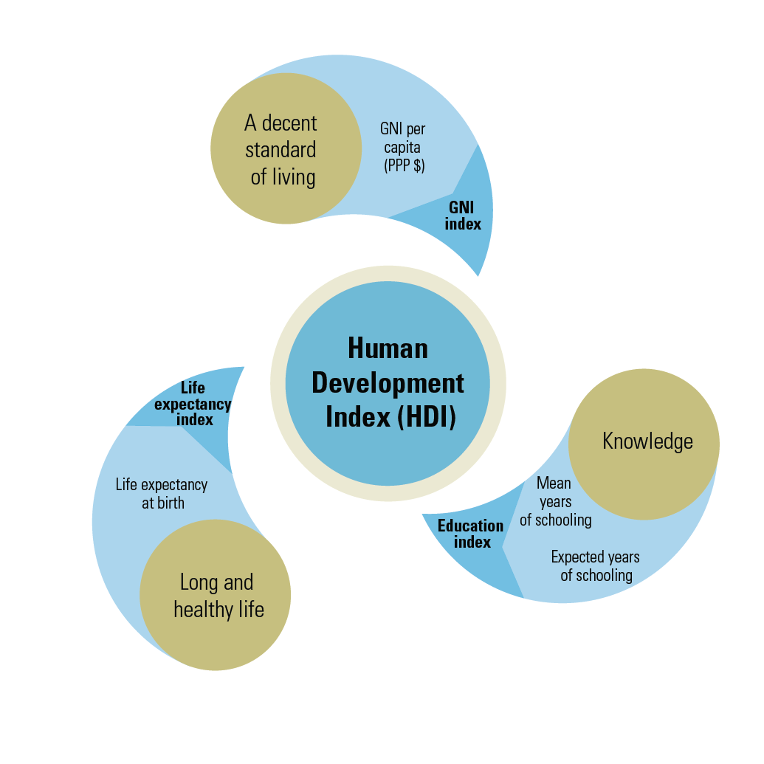

COMMON TERMS
HUMAN DEVELOPMENT INDEX

Slide 7
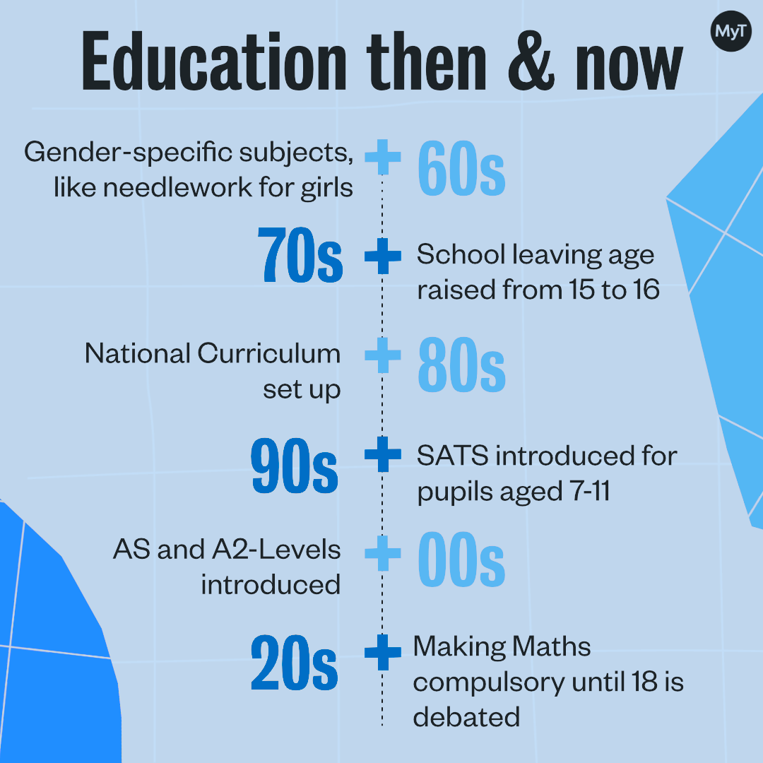
2. MEAN YEARS OF SCHOOLING

Slide 8
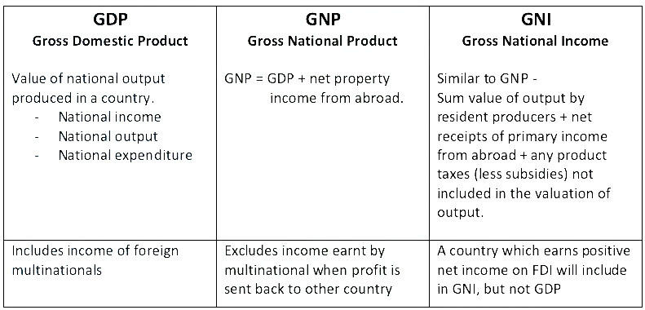
3.GNIPC (GROSS NATIONAL INCOME PER CAPITA)
is an economic indicator that represents the average income per person in a country, after accounting for the total income generated by the nation's residents, both domestically and abroad

Slide 9
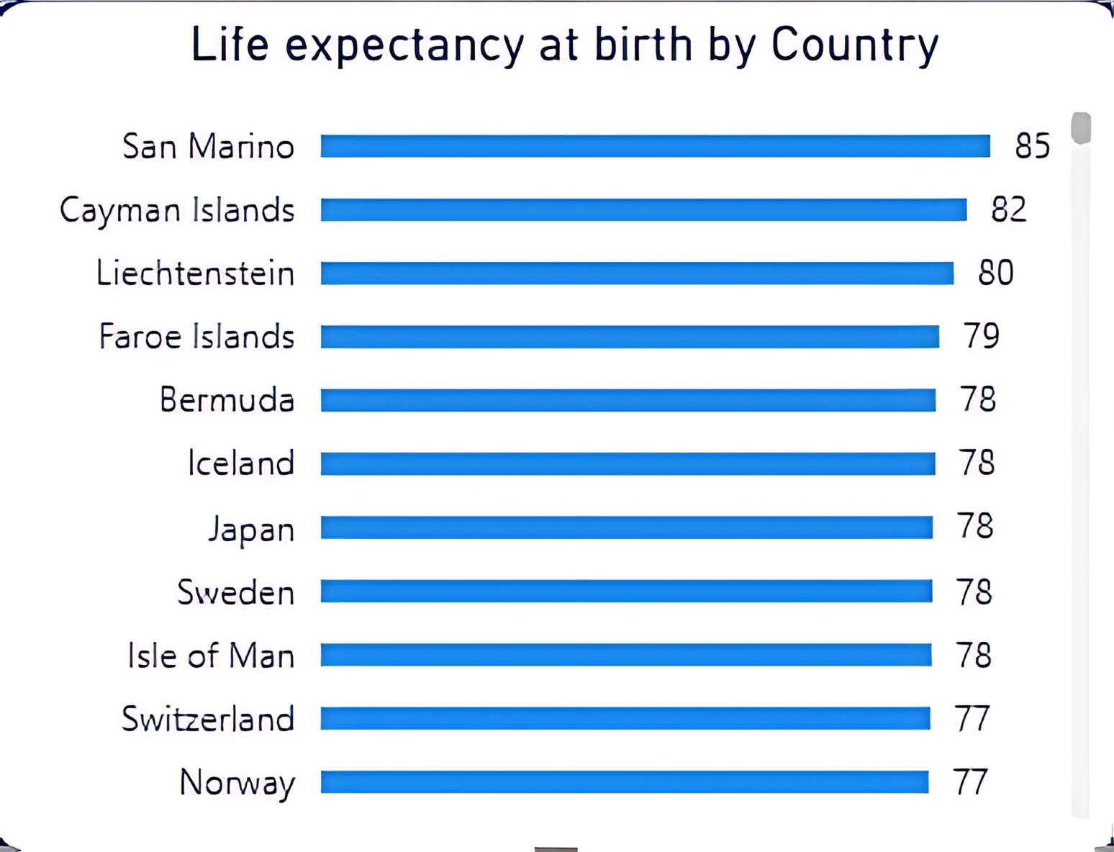

4.LIFE EXPECTANCY AT BIRTH
a statistical measure that estimates the average number of years a newborn is expected to live, assuming that current mortality rates remain constant throughout their life.

Slide 10
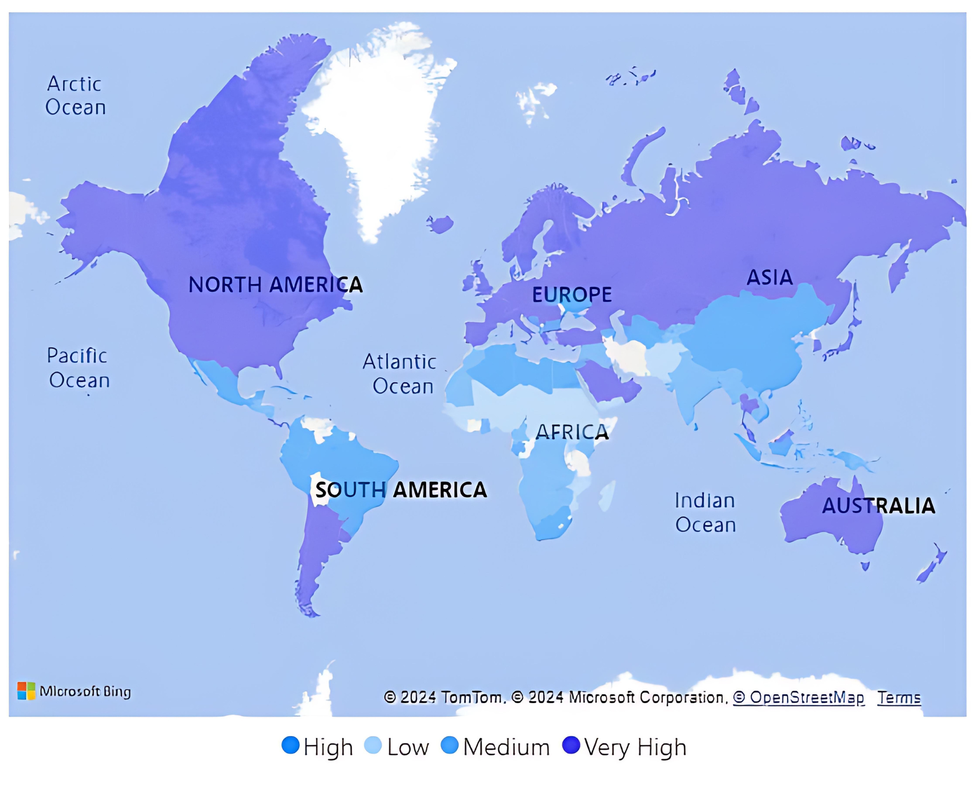
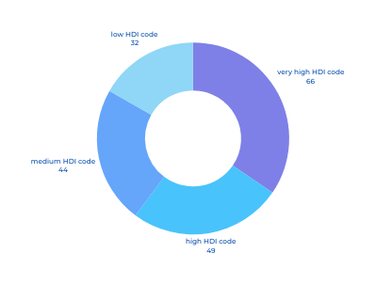
TOTAL CUNTRIES ANALYZED
191

Slide 11

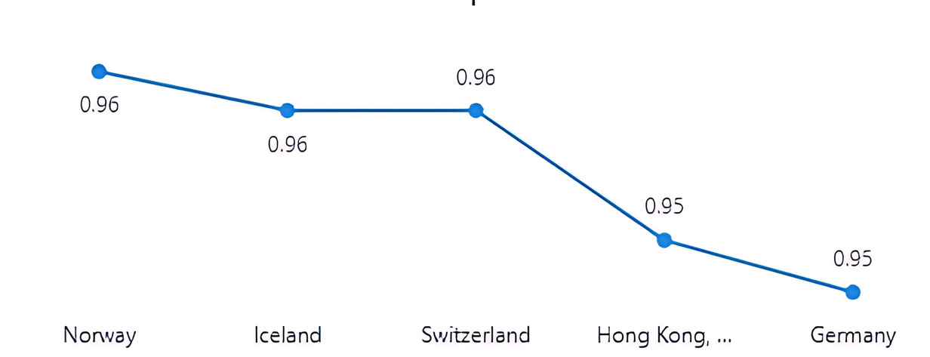
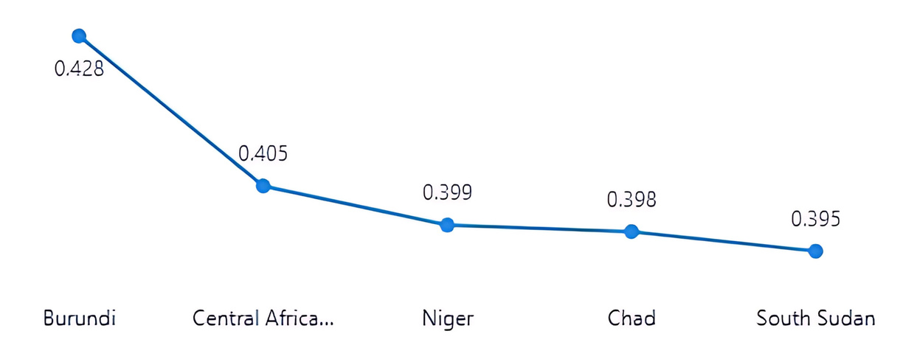


AS OF 2018
BOTTOM 5 COUNTRIES BY HDI (2018)
SOUTH SUDAN= 39.5%
CHAD = 39.8%
NIGER = 39.9%
CENTRAL AFRICAN REPUBLIC = 40.5%
BURUNDI= 42.8%
TOP 5 COUNTRIES BY HDI (2018)
NORWAY = 95.7%
IRELAND & SWITZERLAND = 95.5%
HONG KONG = 94.9%
GERMANY = 94.7%
LIFE EXPECTANCY AT BIRTH: 77 YEARS
EXPECTED YEARS OF SCHOOLING: 13 YEARS
GROSS NATIONAL INCOME PER CAPITA: $ 103K
INTERNET USAGE RATE: 96.7%
LIFE EXPECTANCY AT BIRTH: 44 YEARS
EXPECTED YEARS OF SCHOOLING: 5.7 YEARS
GROSS NATIONAL INCOME PER CAPITA: $ 1,8K
INTERNET USAGE RATE: 0.38%

Slide 12

IN THE NEXT SLIDES WE WILL SHOW SOME OF THE ANALYSES FROM THE DASHBOARD THAT WE HAVE REACHED ABOUT EGYPT BETWEEN THE YEARS 2000-2018.

Slide 13
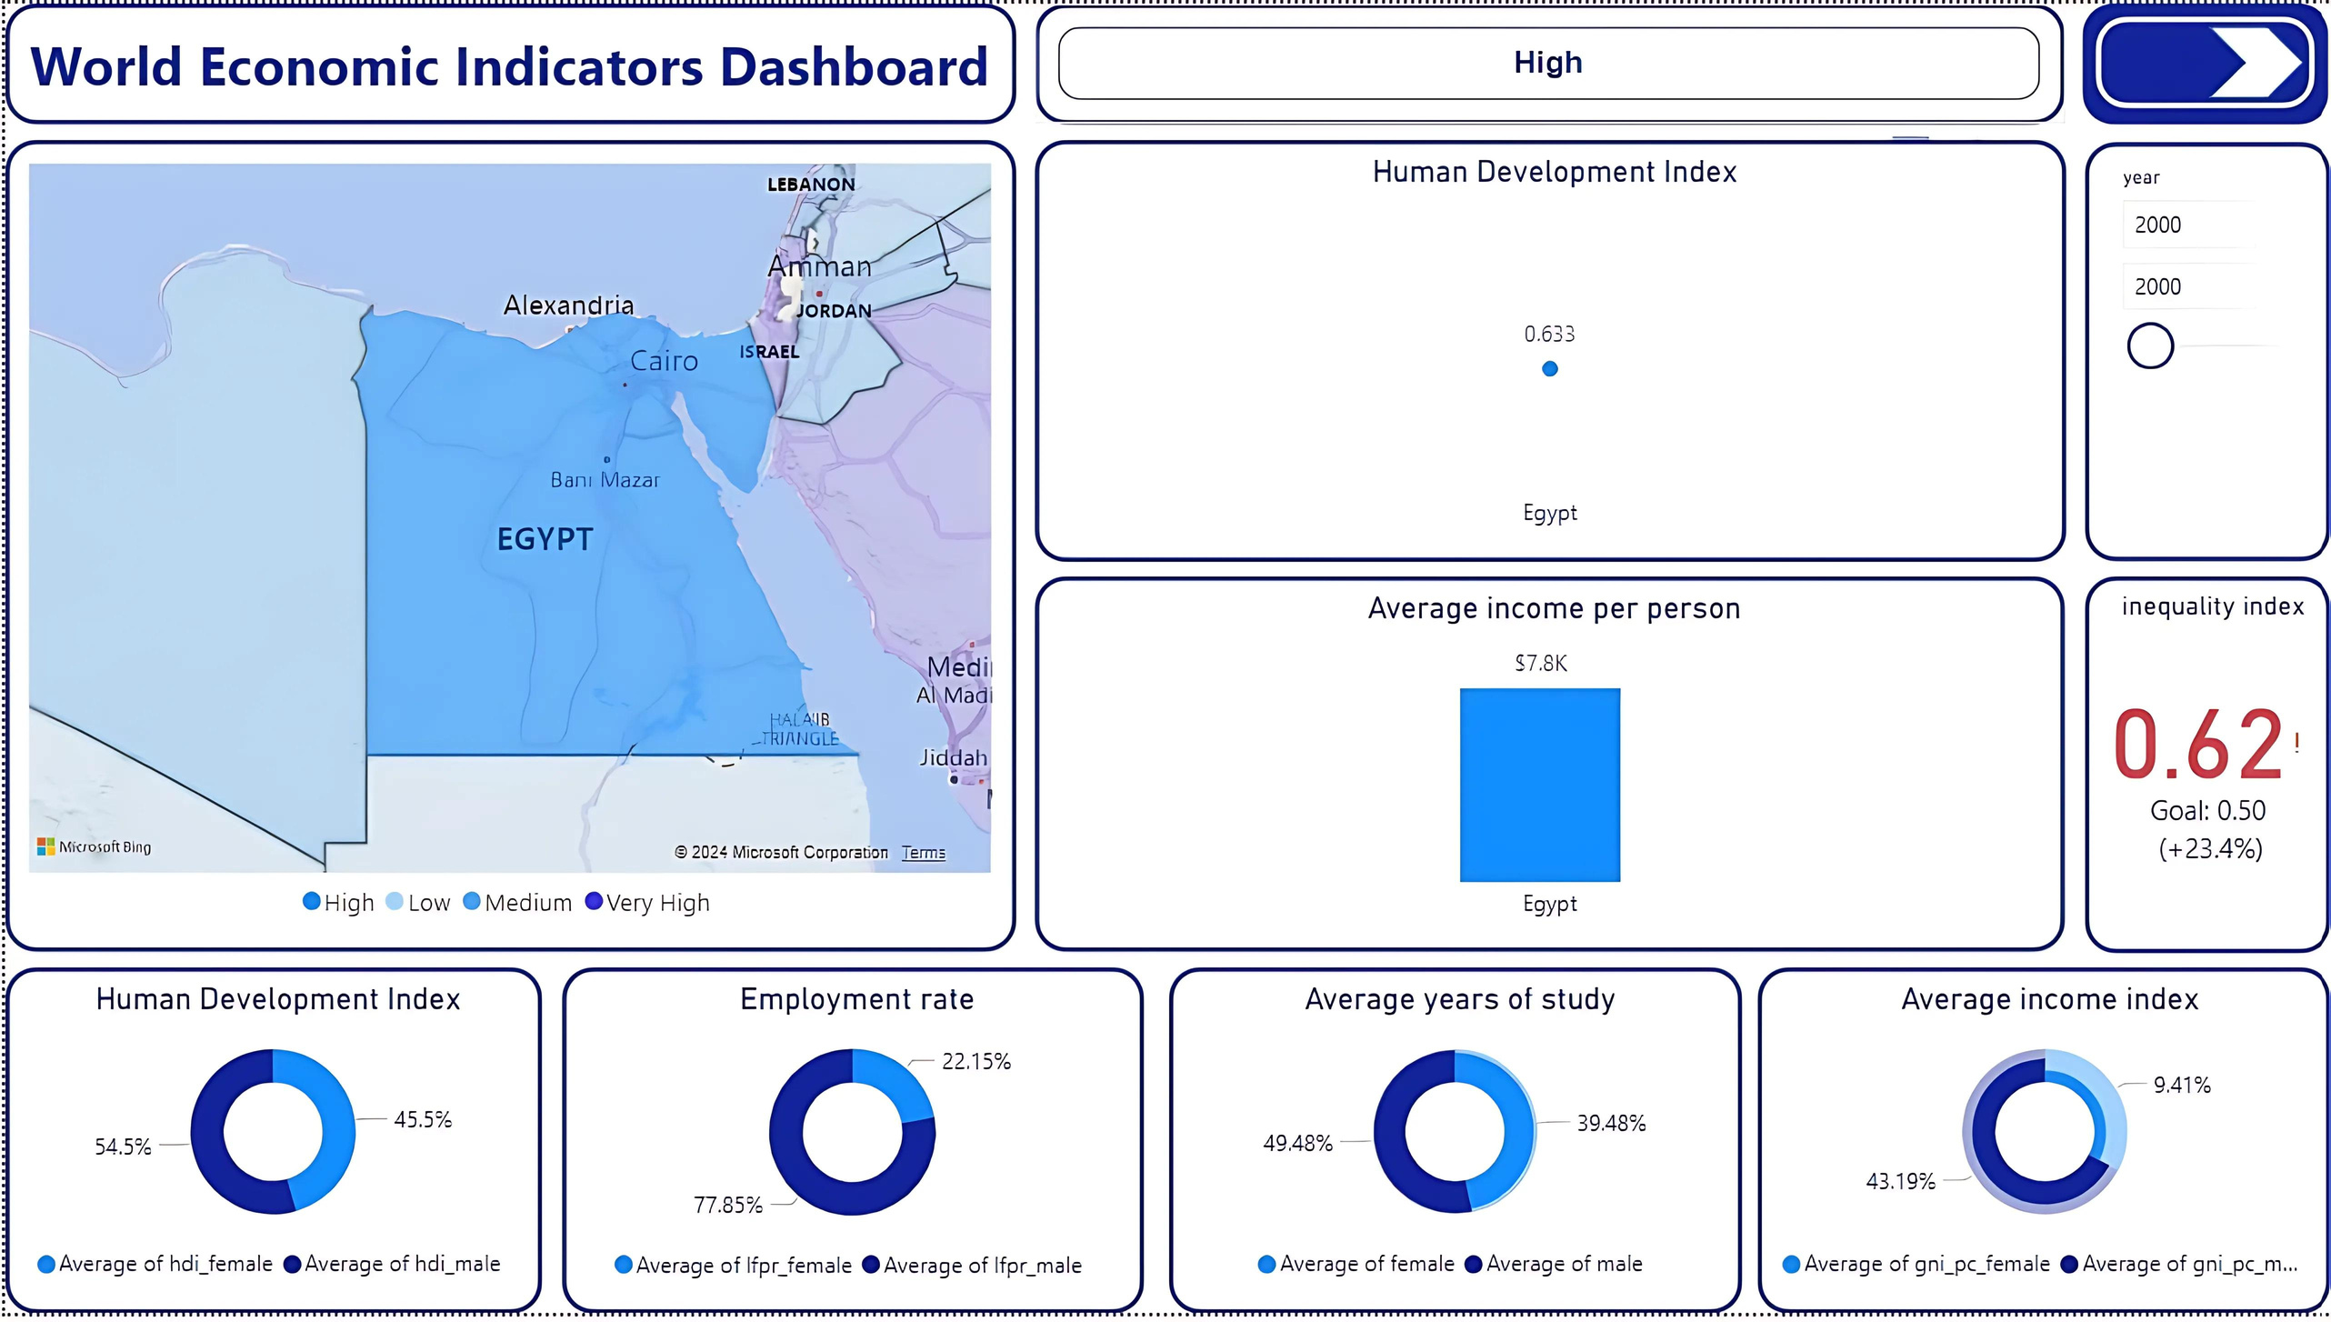

Slide 14

2000
2018
TOP 5 COUNTRIES BY HDI (2018)
NORWAY = 95.7%
IRELAND & SWITZERLAND = 95.5%
HONG KONG = 94.9%
GERMANY = 94.7%
LIFE EXPECTANCY AT BIRTH: 77 YEARS
EXPECTED YEARS OF SCHOOLING: 13 YEARS
GROSS NATIONAL INCOME PER CAPITA: $ 103K
INTERNET USAGE RATE: 96.7%

Slide 15
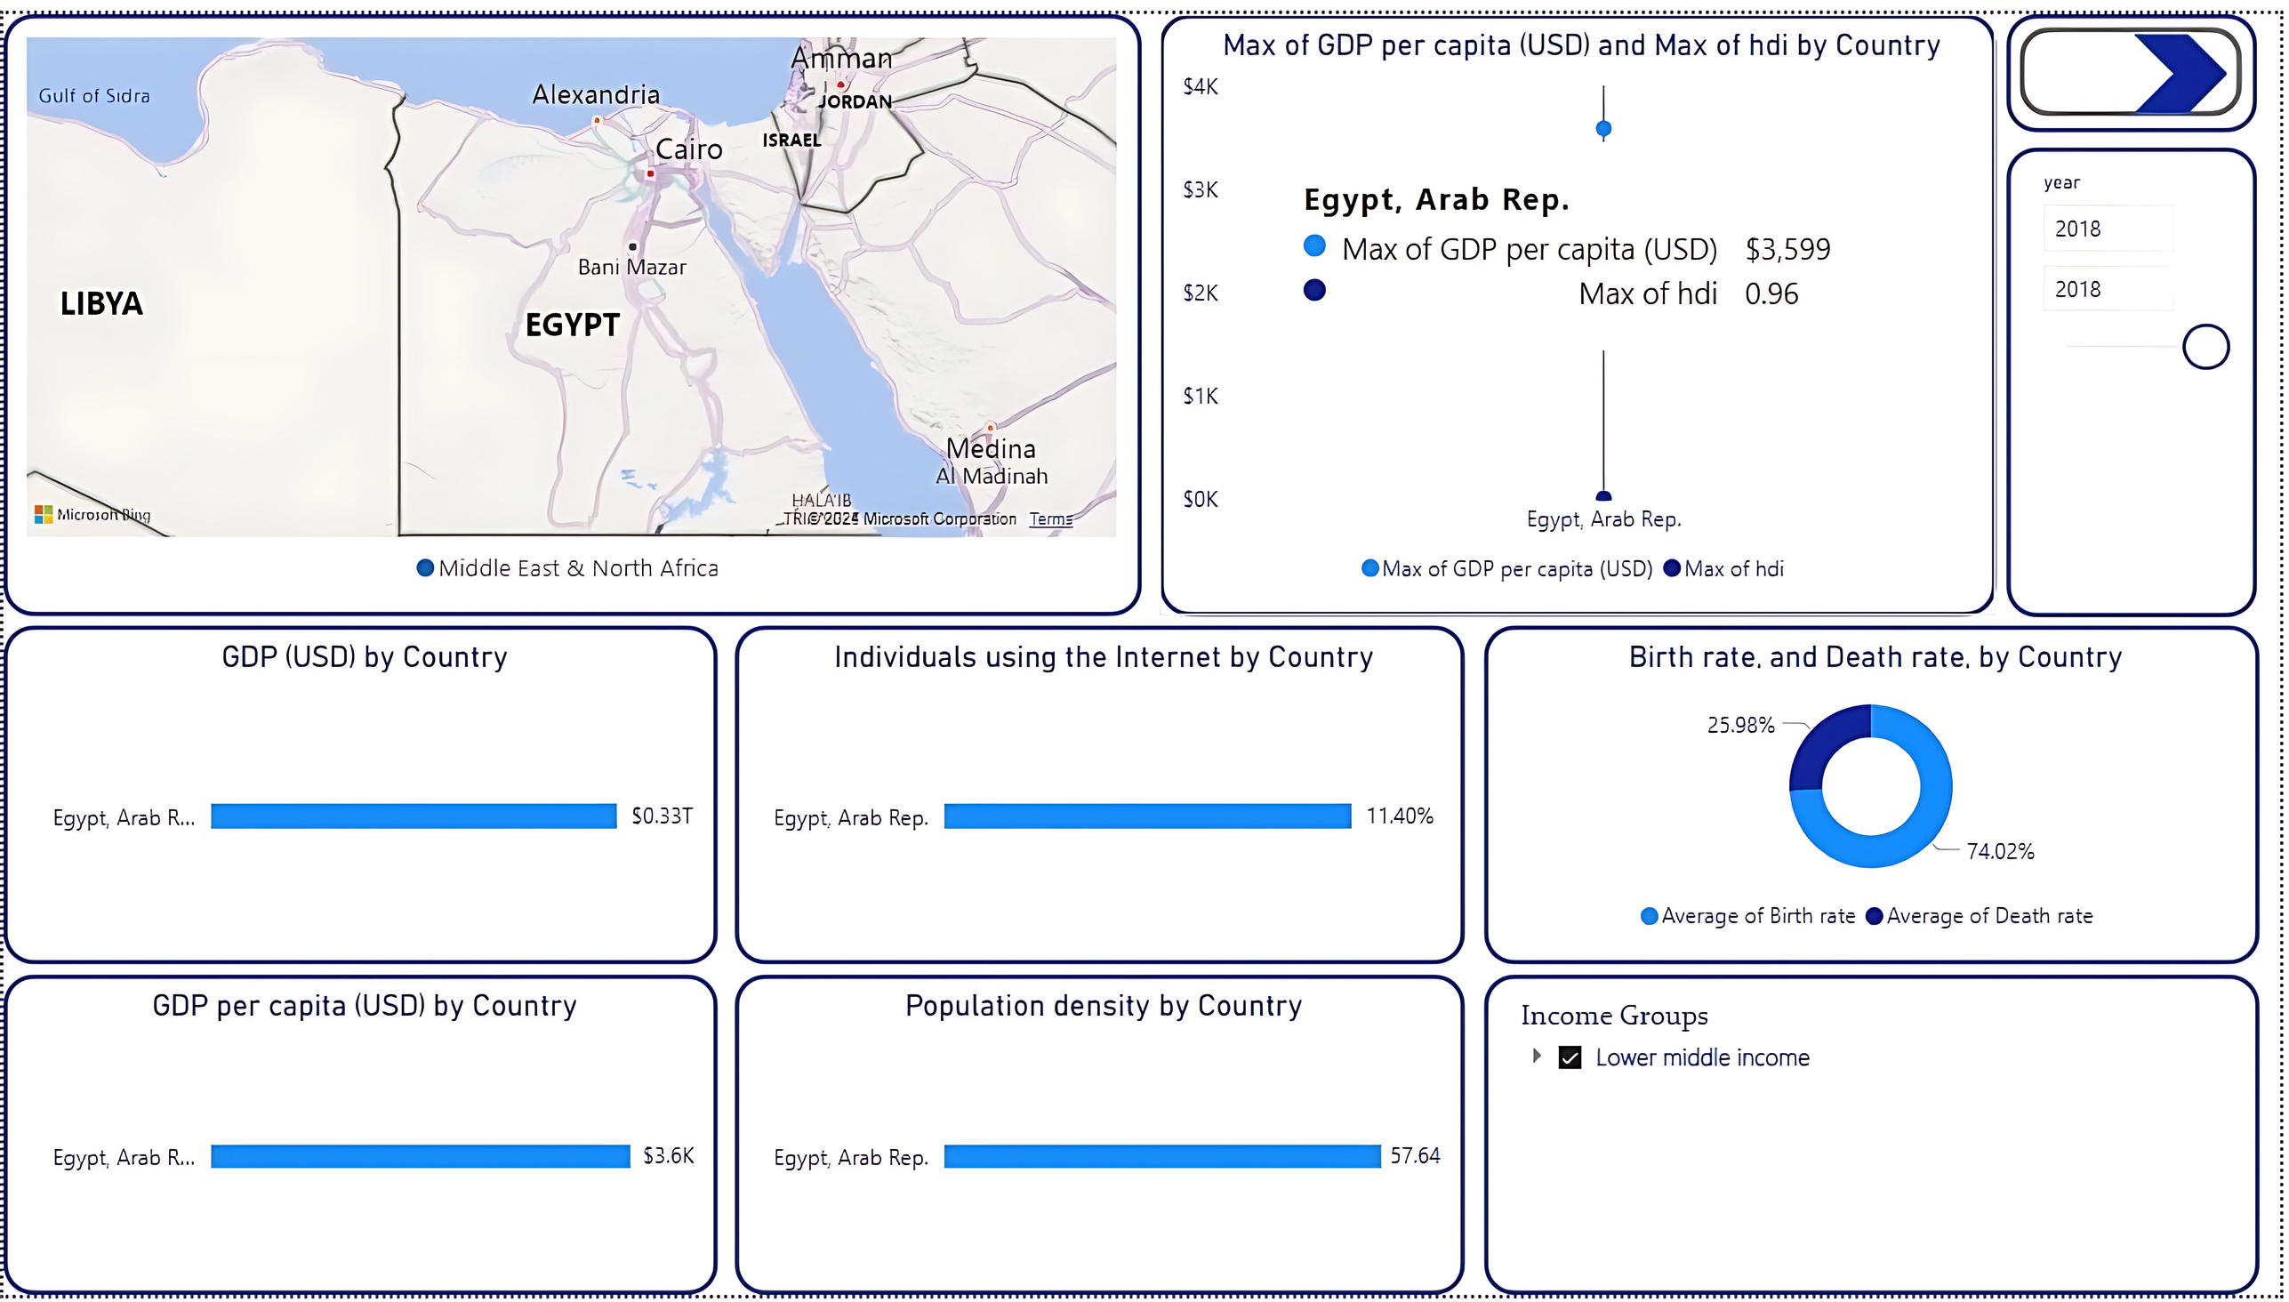

Slide 16
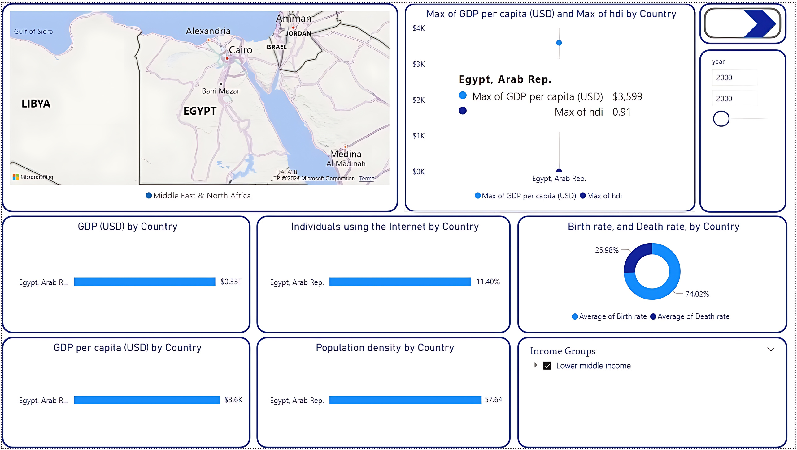

Slide 17
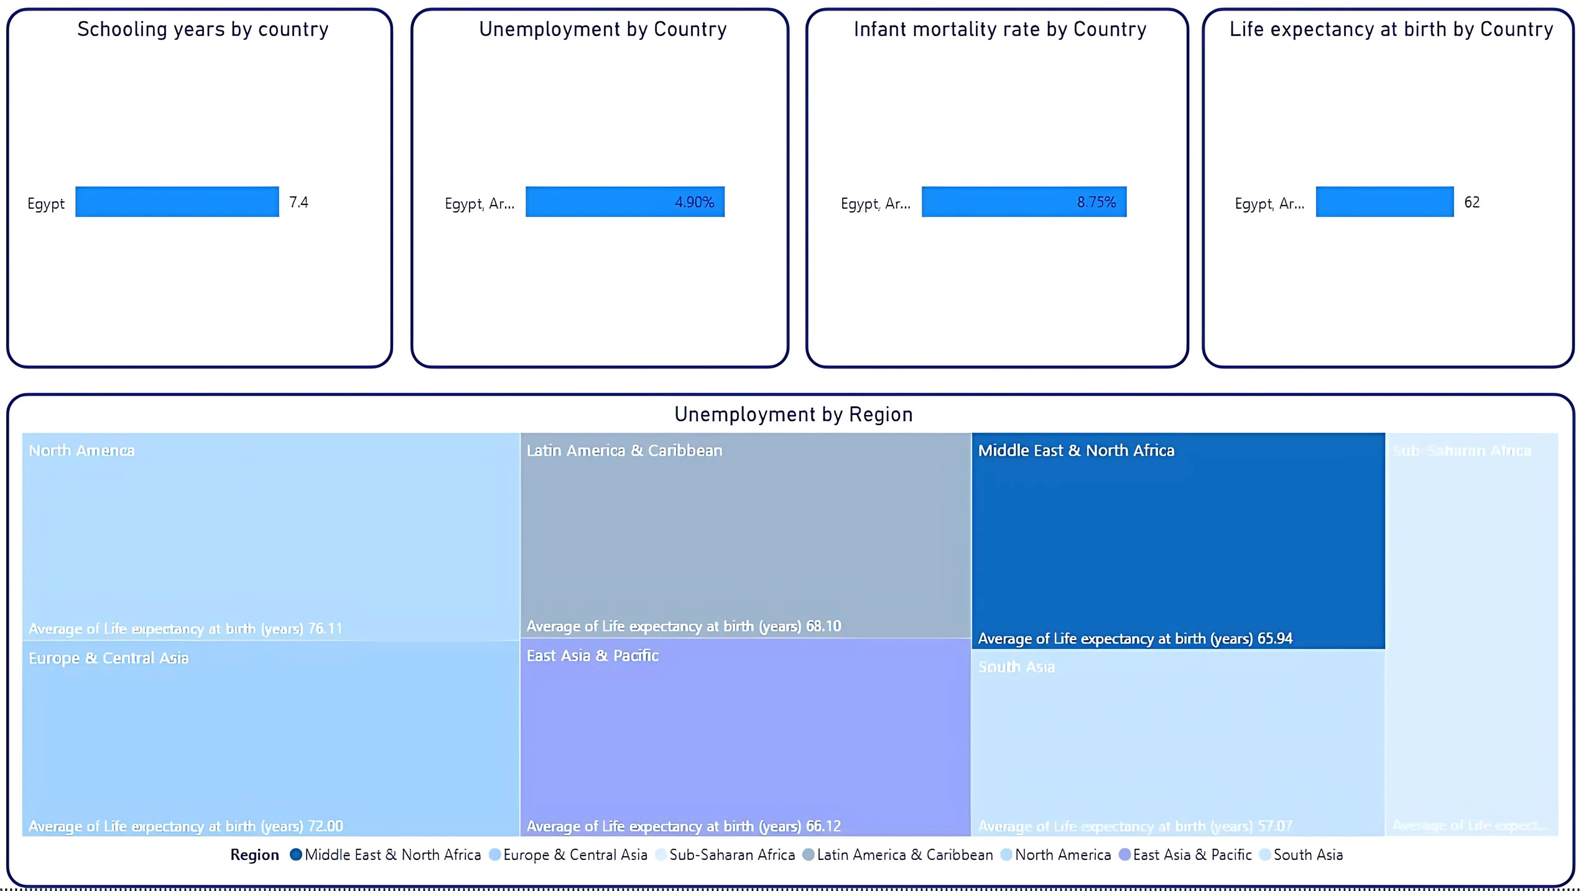

Slide 18

FROM THE DASHBOARD, WE CAN ANSWER MANY QUESTIONS, INCLUDING:
Which countries have achieved the highest economic growth rate in recent years?
Which countries suffer from the highest unemployment rate?
How do per capita income levels differ between developed and developing countries?
How does the birth rate or death rate affect countries' income?
How do labor force participants affect countries' income? Male / Female
How does gender inequality affect countries' income?
How does the Human Development Index affect income?

Slide 19



MEMBERS TEAM
KAWTHER ABDULLAH
JOHN MAGDY
IMAN HOSSAM
ISLAM OSAMA
ESRAA GAMAL
LOBNA ALI

Slide 20

THANK YOU

